Slide 1

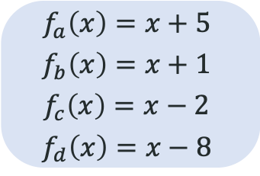
推理复杂度
记忆复杂度
记忆
函数关系
(a, b, x) = x + 6
(b, a, x) = x + 6
(a, c, x) = x + 3
(c, a, x) = x + 3
(a, d, x) = x - 3
(d, a, x) = x - 3
(c, b, x) = x - 1
(b, c, x) = x - 1
(d, b, x) = x - 9
(b, d, x) = x - 9
(c, d, x) = x + 6
(d, c, x) = x + 6
(a, a, x) = x + 10
(b, b, x) = x + 2
(c, c, x) = x - 4
(d, d, x) = x - 16
(a, b, 21) = 27, (b, a, 29) = 35
(b, a, 50) = 56, (a, b, 31) = 37
(a, c, 16) = 19, (c, a, 16) = 19
(a, d, 67) = 64, (d, a, 99) = 96
(c, b, 60) = 59, (b, c, 50) = 49
(d, b, 48) = 39, (b, d, 33) = 24
(c, d, 77) = 83, (d, c, 90) = 96
(a, a, 58) = 68, (a, a, 51) = 61
(b, b, 46) = 48, (b, b, 35) = 37
(c, c, 36) = 32, (c, c, 29) = 25
(d, d, 88) = 54, (d, d, 46) = 30
对称性
(a, b, x) = (b, a, x) = x + 6
(a, c, x) = (c, a, x) = x + 3
(a, d, x) = (d, a, x) = x - 3
(c, b, x) = (b, c, x) = x - 1
(d, b, x) = (b, d, x) = x - 9
(c, d, x) = (d, c, x) = x + 6
(a, a, x) = x + 10
(b, b, x) = x + 2
(c, c, x) = x - 4
(d, d, x) = x - 16
复合关系
$$f_{a}\left(x\right)=x+5$$
$$f_{b}\left(x\right)=x+1$$
$$f_{c}\left(x\right)=x−2$$
$$f_{d}\left(x\right)=x−8$$
…
$γ$ 逐渐变大
Zhongwang Zhang, Pengxiao Lin, Zhiwei Wang, Yaoyu Zhang, Zhi-Qin John Xu*, Initialization is Critical to Whether Transformers Fit Composite Functions by Inference or Memorizing, NeurIPS 2024

